Slide 1
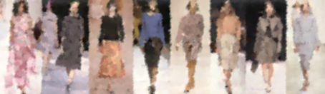
Fashion-MNIST Image Classification using Deep Learning
Rjanpreet Kaur
student id:- 2953262
MSc. Artificial Intelligence

Slide 2
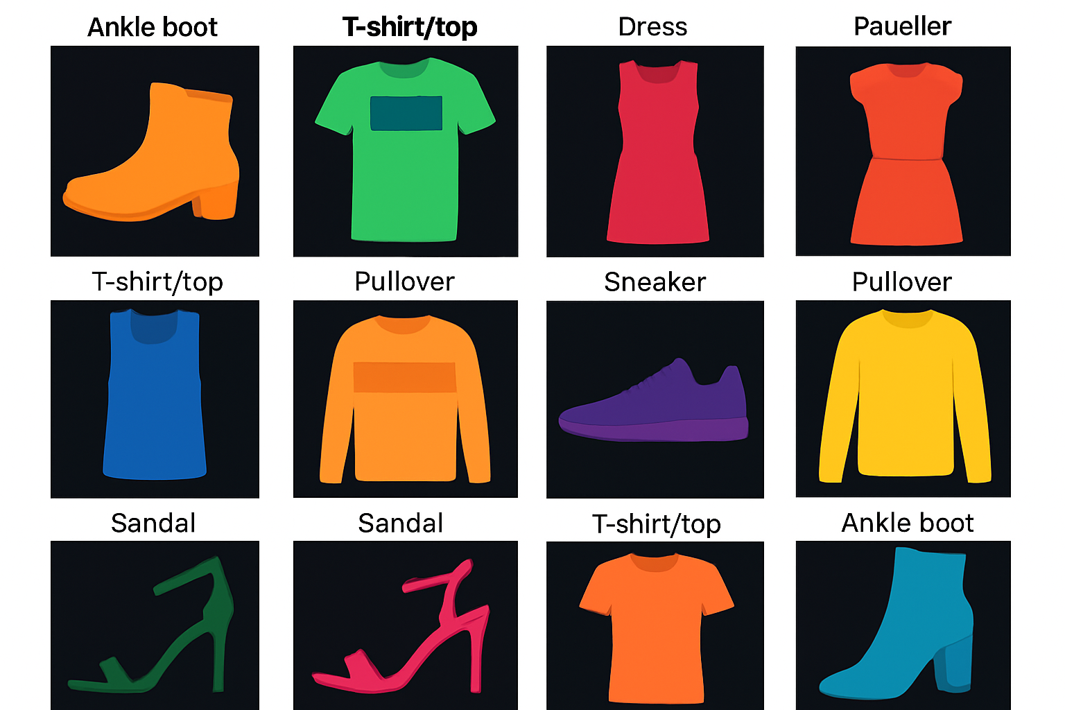
Introduction
Fashion-MNIST is a dataset of grayscale clothing images (10 categories).
Project goal: classify clothing images using deep learning architectures.
Chosen for benchmarking visual classification performance.
Problem: improving accuracy across model complexity levels.

Slide 3
Objectives / Goals
Train and compare three architectures: MLP, CNN, and convNexT-Tiny.
Achieve over 90% accuracy using transfer learning.
Analyze performance using confusion metrics and per-class metrics.
Identify model strengths and weaknesses.

Slide 4
METHODOLOGY
Dataset: Fashion-MNIST (60,000 train + 10,000 test samples).
Framework: PyTorch and torchvision for model training.
Split: 80% training, 20% validation.
Applied data augmentation and normalization.
Models: Simple MLP, Simple CNN, and ConvNeXt-Tiny (transfer learning).
Training: AdamW /SGD optimizers with LR scheduling.
Workflow: Dataset → Preprocessing → Model Training → Evaluation.
Evaluation: accuracy, confusion matrix, classification report.

Slide 5
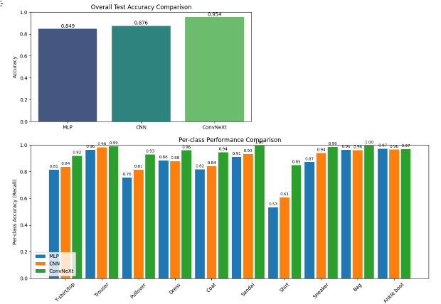
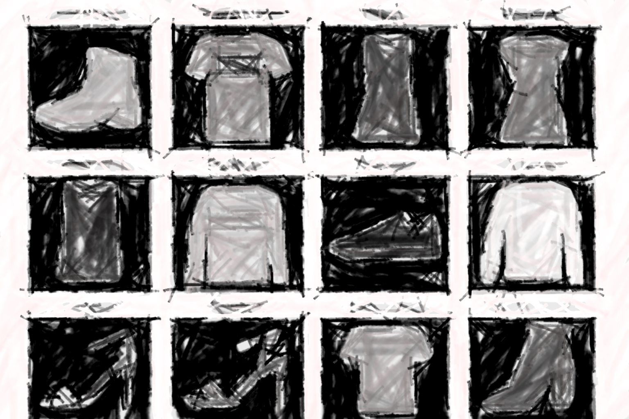
DATA PREPROCESSING
PERFORMANCE
METRICS
Fashion MNIST
DATA SPLITTING
ACCURACY
T-shirt
Trousers
Pullover
Dress
Coat
Sandal
Shirt
Sneaker
Bag
Ankle Boot
TRAIN 80%
VAL 20%
PRECISION
RECALL
F1 SCORE
Model Training
Model Evaluation
OUTPUT
CLASIFIER USED
ANN
CNN
ConvNeXt-Tiny

Slide 6
Implementation / Process
Defined reusable PyTorch functions for training and evaluation.
Trained MLP for 12 epochs, CNN for 18 epochs, ConvNeXt-Tiny for 15 epochs.
Used One-Cycle LR scheduler for ConvNeXt optimization.
Plotted training curves to analyze convergence trends.
Generated confusion matrices for each model.

Slide 7
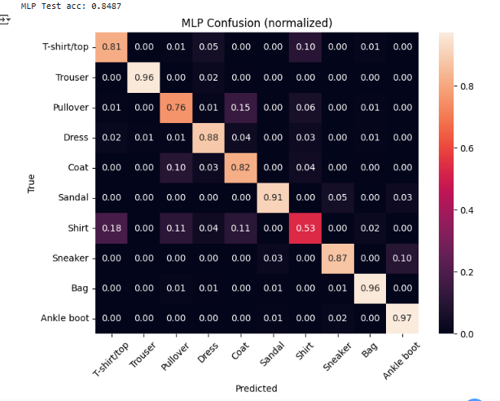
Model 1: Multilayer Perceptron (MLP)
Two dense hidden layers (512, 256 units) with SiLU activation.
Dropout (0.4) for regularization, trained with AdamW optimizer for 12 epochs.
Test accuracy: 84.9%. Struggles with similar categories such as Shirt vs T-shirt.

Slide 8
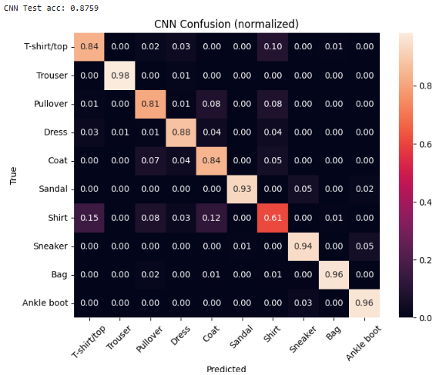
Model 2: Convolutional Neural Network (CNN)
Three convolutional layers (32, 64, 128 filters), max pooling, adaptive average pooling.
Dropout layers to reduce overfitting. Optimized with SGD and learning rate decay.
Test accuracy: 87.6%. Improved spatial pattern detection and robustness.

Slide 9
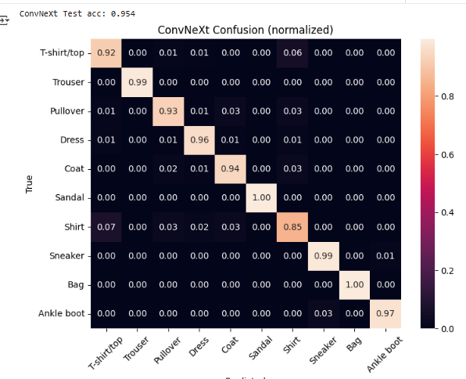
Model 3: ConvNeXt-Tiny (Transfer Learning)
Pre-trained on ImageNet, fine-tuned for Fashion-MNIST with adjusted input/output layers.
Used AdamW optimizer, One-Cycle LR schedule, mixed precision training.
Test accuracy: 95.4%. Best generalization; minor shirt/top confusion remains.

Slide 10
Results / Findings
MLP Test Accuracy: 84.87%.
CNN Test Accuracy: 87.59%.
ConvNeXt-Tiny Test Accuracy: 95.4%.
Transfer learning significantly improved performance.
Best model: ConvNeXt-Tiny with 95.4% test accuracy.

Slide 11
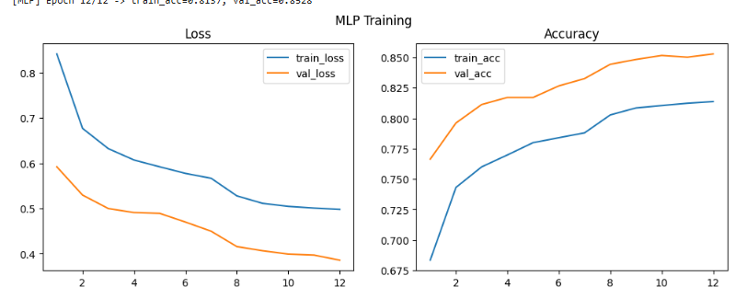
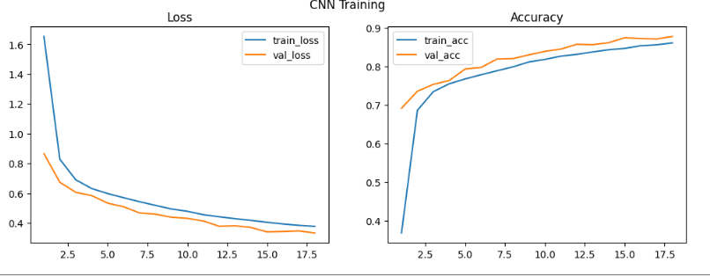
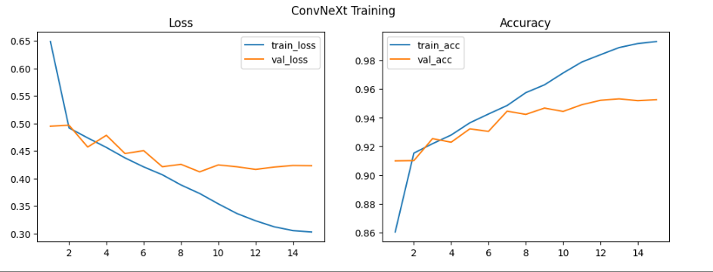
LOSS & ACCURACY CURVE OF MLP,CNN, ConvNeXT

Slide 12
OVERALL COMPARISON CHART

Slide 13
Discussion
Deeper models capture complex visual features better.
ConvNeXt achieved near state-of-the-art performance.
Common confusion: Shirt vs T-shirt/Top due to similarity.
Model comparison shows accuracy gain with transfer learning.
Challenges: computational demand and overfitting prevention.

Slide 14
Conclusion
Project successfully trained and compared multiple architectures.
ConvNeXt-Tiny achieved the highest test accuracy (95.4%).
Demonstrated impact of architecture and data augmentation.
Contributed insights into model selection for image classification tasks.

Slide 15
Future Work / Acknowledgments
Future work: experiment with Res-Net, Vision Transformers, and tuning.
Implement interpretability tools (Grad-CAM).
Acknowledgments: PyTorch, torchvision, Google Colab.
Special thanks to MSc AI faculty and mentors.

